Slide 1
Introduction to
Fuzzy sets & Fuzzy Logic
References
Fuzzy Logic with Engineering Applications, By Timothy J. Ross, 2nd Edition, University of New Mexico, USA.
Fuzzy Sets and Fuzzy Logic, By Jeroge Killer and Bo Yuan, PHI, New Jersey.
PPT from Joakim Lindblad, Centre for Image Analysis Uppsala University.
PPT from Dr Bogdan L. Vrusias, b.vrusias@surrey.ac.uk

Slide 2
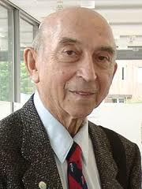
Lotfi Asker Zadeh
Born February 4, 1923 is mathematician and computer Scientist and Professor of Computer Science at the University of California, Berkeley.
He Published his Seminal Work on Fuzzy set in 1965.
In 1973 he proposed the theory of fuzzy logic.

Slide 3
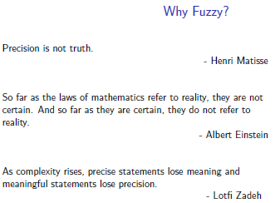


Slide 4


Contents
Introduction to Fuzzy sets
Classical sets Vs. Fuzzy sets
Basic Terms of Fuzzy logic.
Operations on fuzzy sets
  Fuzzy Union, Intersection, Complement, etc..
Properties of Fuzzy sets
  Equal fuzzy sets
  Support of Fuzzy sets
  Cardinality of fuzzy sets
  An Empty fuzzy sets
  Introduction -cuts (Strong cuts and weak)

Slide 5
Introduction to fuzzy
What is fuzzy ? Why the term fuzzy is used ?
“fuzziness” is found in our daily decisions, in our thinking the way we propose our information & particularly in language statements.
The statements can be unclear subject to different interaction phrases like
“a little more”, “very well”, “ see u later”
“very cold”, “ very short”, “may be may not”
“Very fast”, “too slow”, etc …..

Slide 6
Classical set Vs Fuzzy sets
Classical Sets
Works on binary logic (ON/OFF, TRUE /FALSE)
Classical sets contain objects that satisfy precise properties of membership.
Example
Is the person nearly 6 feet tall?
The degree to which the person approaches a height of 6 feet is fuzzy.
For example, the set of heights from 5 to 7 feet is precise (crisp);
Fuzzy Sets
Works on Trivalent logic [ 0 0.5 1 ] [0, 1]
fuzzy sets contain objects that satisfy imprecise properties of membership, i.e., membership of an object in a fuzzy set can be approximate.
These properties and operations are the basis on which the fuzzy sets are used to deal with uncertainty on the one hand and to represent knowledge on the other.

Slide 7
Classical set Vs Fuzzy sets
In classic sets, the transition of an element in the universe between being a member and non member in a given set is abrupt.
In fuzzy sets, this transition occurs gradually.
A fuzzy set is a set containing elements that have varying degree of membership in the set.
A fuzzy set is a set containing elements that have varying degree of membership in the set.

Slide 8
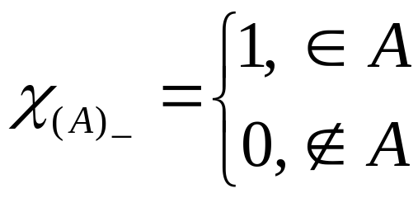
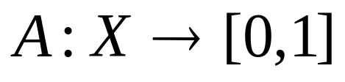
Classical set vs. Fuzzy sets
Crip set can be defined with C.F
Fuzzy Set can be defined by M.F
A fuzzy set A in X is characterized by its membership function
μA : X → [0, 1]
Another notation to define fuzzy set A

Slide 9
There are two main characteristics of fuzzy systems
Fuzzy systems are suitable for uncertain or approximate reasoning, especially for the system with a mathematical model that is difficult to derive.
Fuzzy logic allows decision making with estimated values under incomplete or uncertain information.

Slide 10
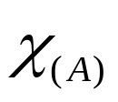
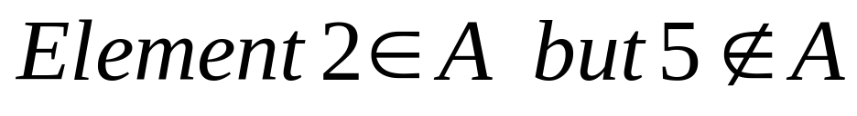
A set is defined by a function usually called as characteristic function that declares. Which elements of X are members of the set & which are not.
A set is defined by C.F as follows
For example A={1, 2, 3, 4}

Slide 11
Basic Terms of Fuzzy logic
Fuzzy Set : A set that allows its elements to have degree of membership these degrees range from zero when the element is not in the set, to one when the element is in the set.
Fuzzification: Changing a crisp number or set to fuzzy nor / set
Fuzzy logic: A scheme of systamatic analysis that uses liguistic variables such as very little, too short, etc.. As opposed to binary logic which is restricted to true/false states
Membership function: Mapping that assoicates each element is set with its degree of membership it can be expressed a discrete values or as a continous function, tringular, trapezoidal & Guassian function are commonly used.
Defuzzification: Finding the best crisp function representation of given fuzzy set

Slide 12
Definition 1. (fuzzy set)
Let X be a nonempty set.
A fuzzy set A in X is characterized by its membership function
μA : X → [0, 1]
and μA(x) is interpreted as the degree of membership of element x in fuzzy set A for each x ∈ X.

Slide 13
Frequently we will write A(x) instead of μA(x).
The family of all fuzzy sets in X is denoted by F(X).
If X = {x1, . . . , xn} is a finite set and A is a fuzzy
set in X then we often use the notation
A = μ1/x1 + ・ ・ ・ + μn/xn
where the term μi/xi, i = 1, . . . , n signifies that
μi is the grade of membership of xi in A and the plus
sign represents the union.

Slide 14
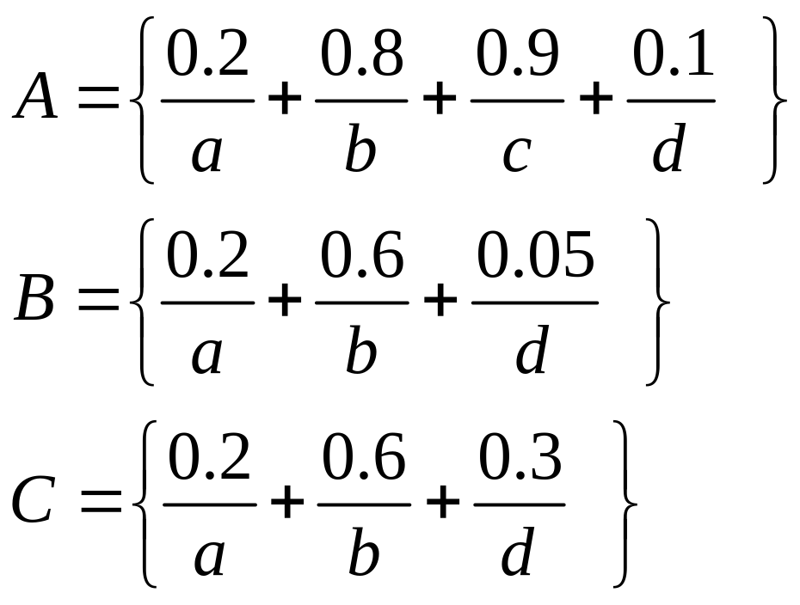
Fuzzy sets
Let X be the universal set and fuzzy set in X are A, B, and C

Slide 15
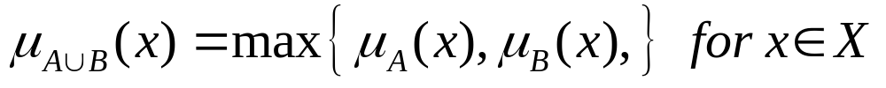
Operations on fuzzy Sets
Union
  Crisp Sets: Which element belongs to either set?
  Fuzzy Sets: How much of the element is in either set?
Let A and B are fuzzy subsets of a nonempty (crisp) set X.
Union : The union of A and B is defined as
union is the largest membership value of the element in either set

Slide 16
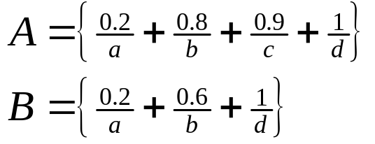
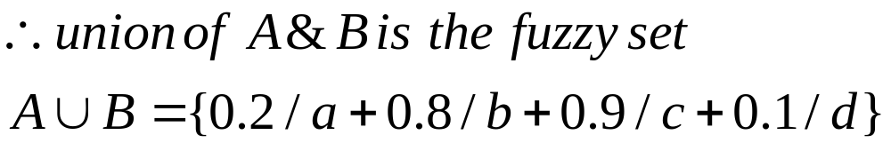
Example of Fuzzy Union
Example: Consider set X={a,b,c,d,e,f,g}and fuzzy set

Slide 17
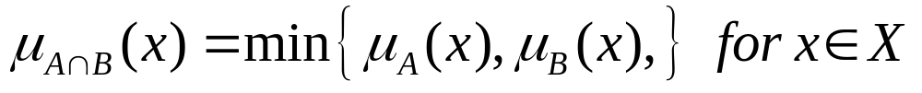
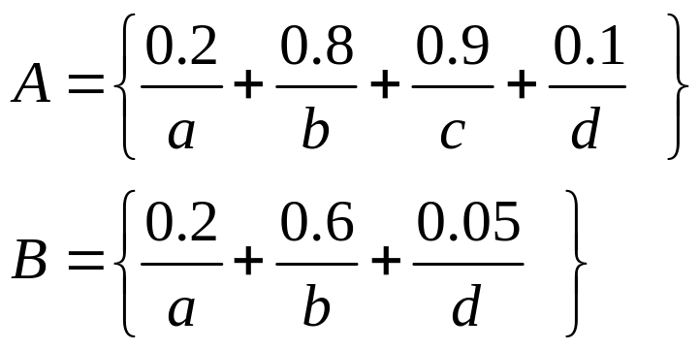
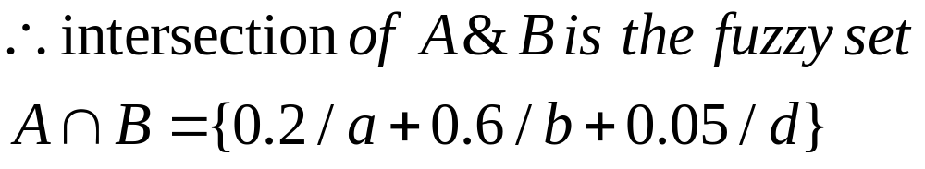
Interection The intersection of A and B is defined as
Example: Consider set X={a,b,c,d,e,f,g}and fuzzy set
Intersection is the Smallest membership value of the element in either set

Slide 18
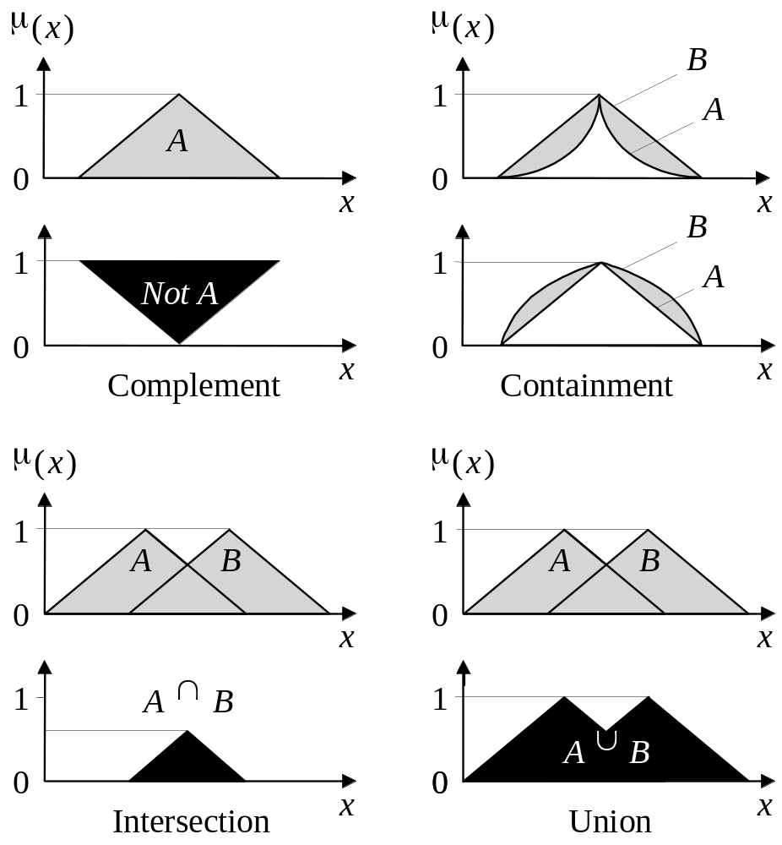
Operations of Fuzzy Sets

Slide 19

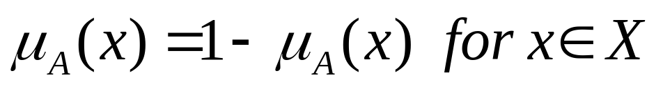
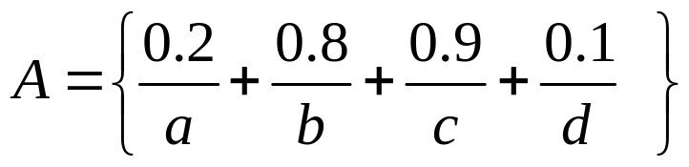
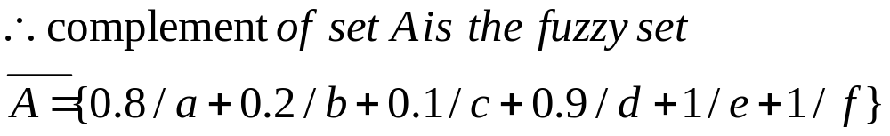
Complement: The complement of fuzzy set A denoted by in X is defined by the membership function
Example: Consider set X={a,b,c,d,e,f,g}and fuzzy set

Slide 20
Properties of Fuzzy sets
  Equal fuzzy sets
  Cardinality of fuzzy sets
  An Empty fuzzy sets
  Introduction -cuts (Strong cuts and weak)

Slide 21

Equality (Equal fuzzy set)
Fuzzy set A is considered equal to a fuzzy set B, IF AND ONLY IF (iff):
μ_{A}(x) = μ_{B}(x), ∀x ∈ X
A = 0.3/1 + 0.5/2 + 1/3
B = 0.3/1 + 0.5/2 + 1/3
09th October 2006
Bogdan L. Vrusias © 2006

Slide 22




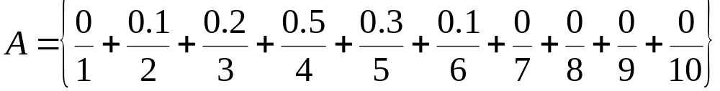
The support of fuzzy set
The a Support of fuzzy set is S(A) which is a crisp set of all
such .
The Element x in X at which is called the crossover point.
A fuzzy set whose support is a single element in X at with
is called a fuzzy singleton.
Example : be the universal set and the fuzzy set in X is
S(A)={2,3,4,5,6} and
x=4 is the crossover point

Slide 23
Cardinality
Cardinality of a non-fuzzy set, Z, is the number of elements in Z. BUT the cardinality of a fuzzy set A, the so-called SIGMA COUNT, is expressed as a SUM of the values of the membership function of A, μ_{A}(x):
card_{A} = μ_{A}(x₁) + μ_{A}(x₂) + … μ_{A}(x_{n}) = Σμ_{A}(x_{i}), for i=1..n
Consider X = {1, 2, 3} and sets A and B
A = 0.3/1 + 0.5/2 + 1/3;
B = 0.5/1 + 0.55/2 + 1/3
card_{A} = 1.8
card_{B} = 2.05

Slide 24
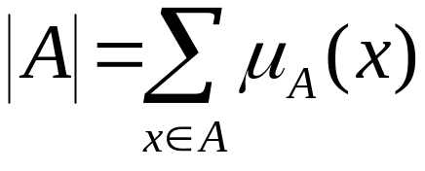
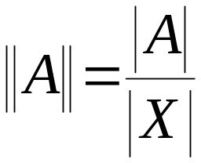

Cardinality of fuzzy sets
The cardinality of a fuzzy set A is defined as
as the relative cardinality as
Where is the cardinality of the universe of discourse

Slide 25
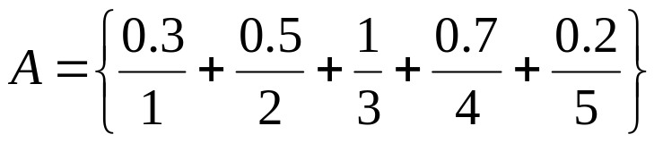


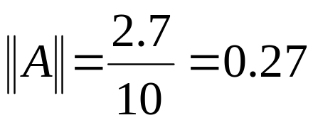
Example of cardinality
Let the universe of discourse be X={1,2,3,4,5,6,7,8,9,10}
Then and
So

Slide 26
Alpha cuts or Level sets
An alpha-cut of the membership function A (denoted a A) is the set of all x such that A(x) is greater than or equal to alpha (a).
Similarly, a strong alpha-cut (denoted a+ A) is the set of all x such that A(x) is strictly greater than alpha (a).
"That is, the alpha-cut (or the strong alpha-cut) of a fuzzy set A is the crips set a A (or the crisp set a+ A) that contains all the elements of the universal set X whose membership grades in A are greater than or equal to (or only greater than) the specified value of alpha."

Slide 27
"That is, the alpha-cut (or the strong alpha-cut) of a fuzzy set A is the crips set aA (or the crisp set a+A) that contains all the elements of the universal set X whose membership grades in A are greater than or equal to (or only greater than) the specified value of alpha."
a A and a+ A are crisp sets because a particular value x either is or isn't in the set; there is no partial membership.

Slide 28


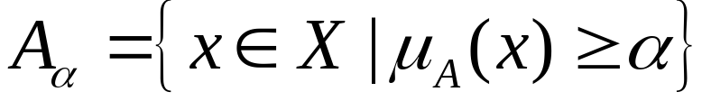
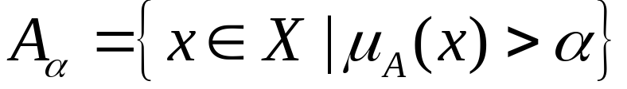
The Level Set or cuts
The - level is the crisp set of elements that belongs to the fuzzy set A at least to the degree .
The Strong - level set or strong - cut is defined as
A fuzzy set is said to be convex if all levels sets are convex

Slide 29
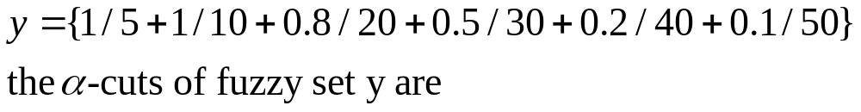
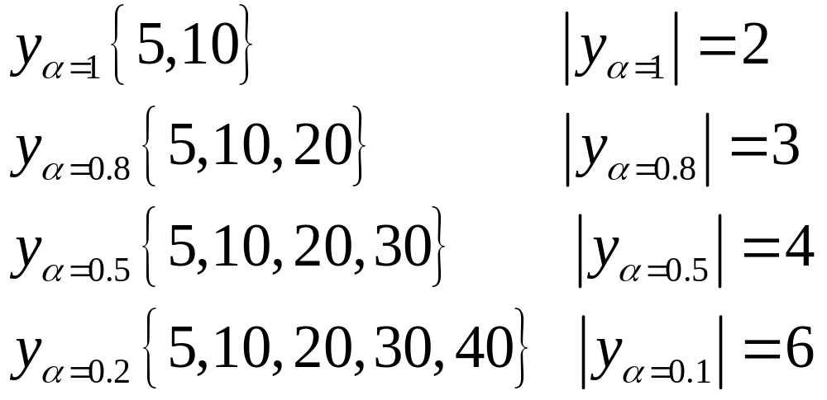
Let x={5, 10, 20, 30, 40, 50, 60, 70, 80} be the set of age of persons consider the fuzzy set Y of young person defined by

Slide 30
Alpha-cut Example
An α-cut or α-level set of a fuzzy set A ⊆ X is an ORDINARY SET A_{α} ⊆ X, such that:
A_{α}={μ_{A}(x)≥α, ∀x ∈ X}.
Consider X = {1, 2, 3} and set A
A = 0.3/1 + 0.5/2 + 1/3
then A_{0.5} = {2, 3},
A_{0.1} = {1, 2, 3},
A₁ = {3}

Slide 31
Empty Fuzzy Set
A fuzzy set A is empty, IF AND ONLY IF:
μ_{A}(x) = 0, ∀x ∈ X
Consider X = {1, 2, 3} and set A
A = 0/1 + 0/2 + 0/3
then A is empty
09th October 2006
Bogdan L. Vrusias © 2006

Slide 32
Some examples

Slide 33
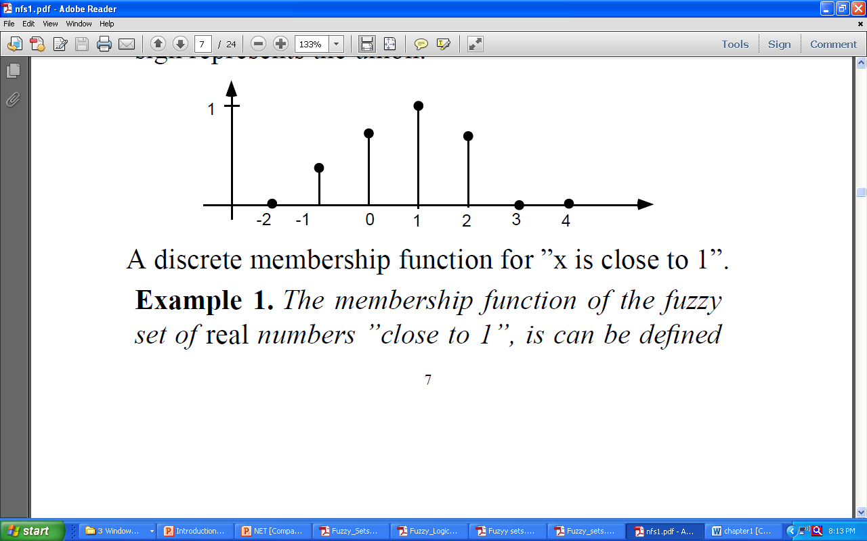

Slide 34
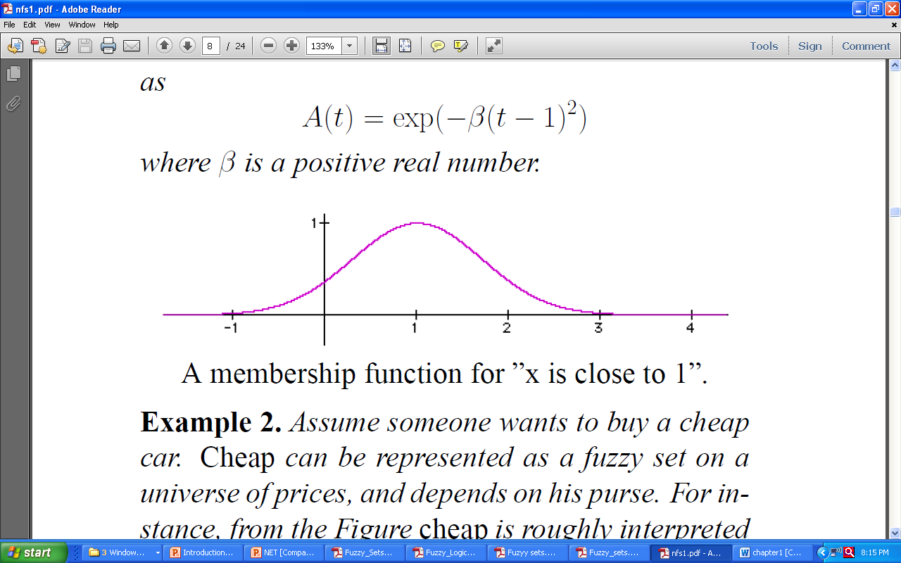

Slide 35
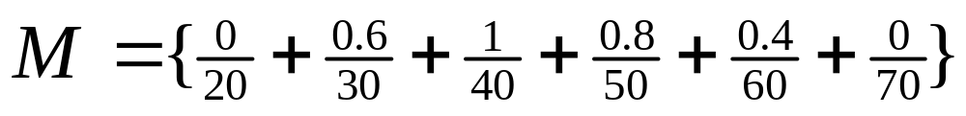
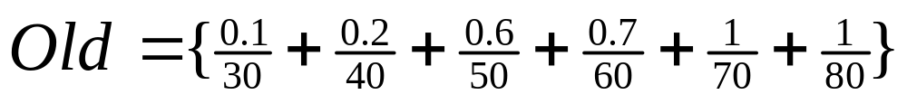
Example for plotting Membership Function
Let x={5, 10, 20, 30, 40, 50, 60, 70, 80} be the set of age of persons consider the fuzzy set Y of young person defined by

Slide 36
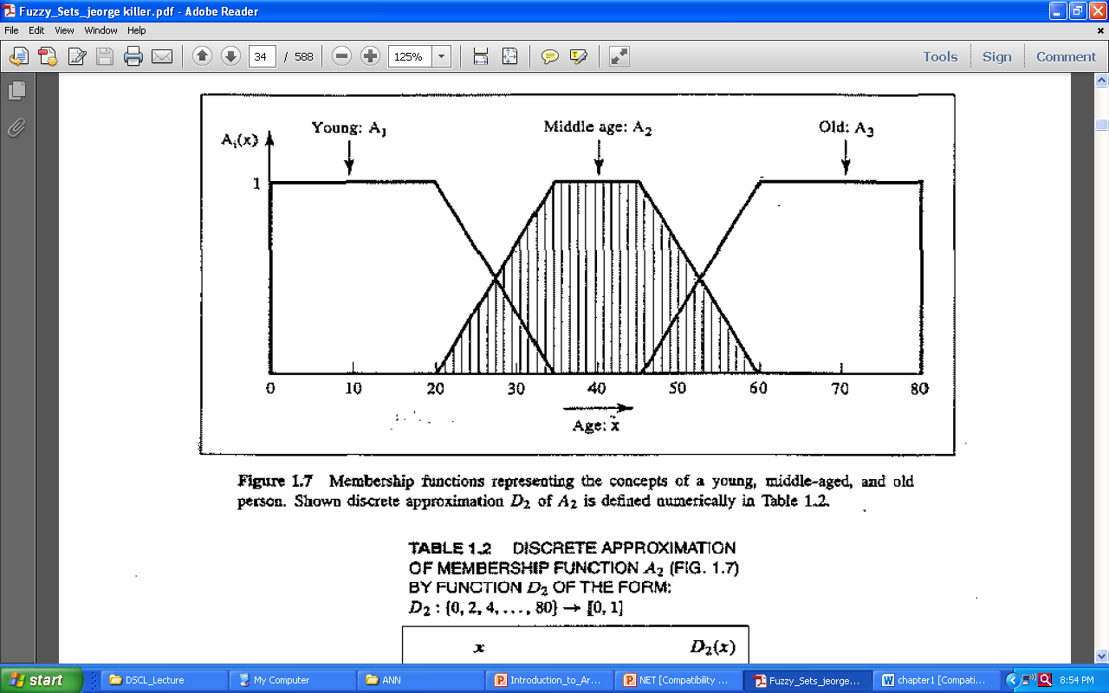

Slide 37
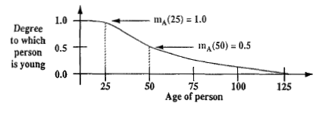

Slide 38

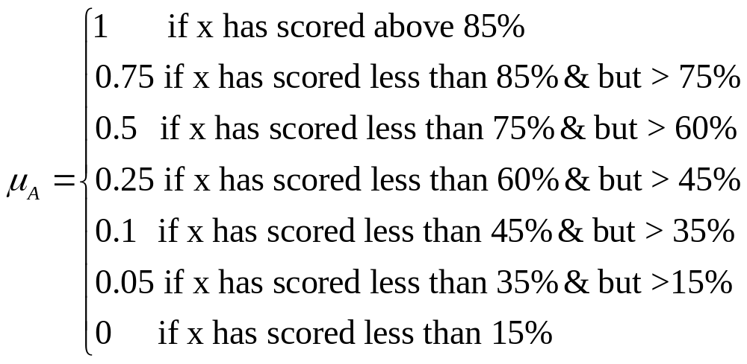
Let us consider the statement : set of Intelligent students

Slide 39
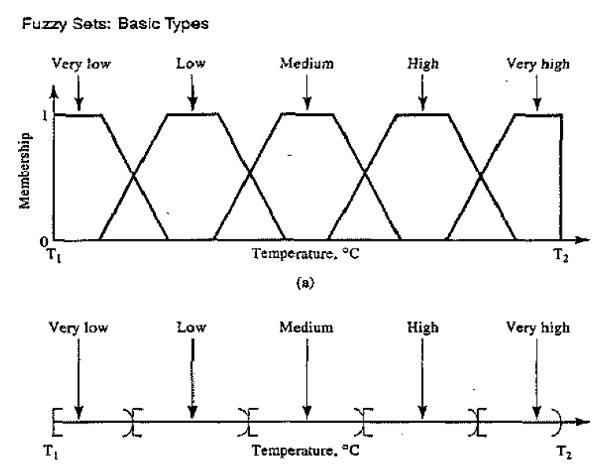

Slide 40
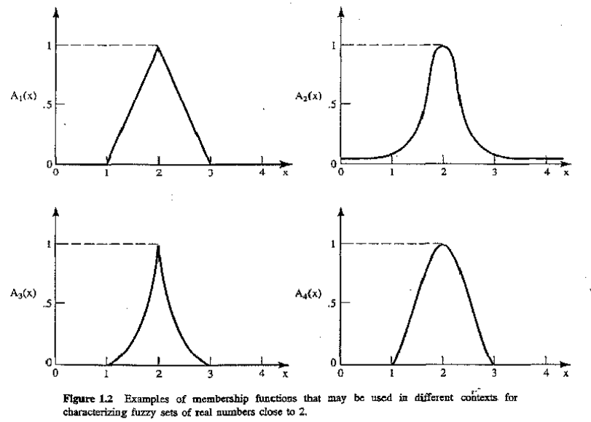

Slide 41


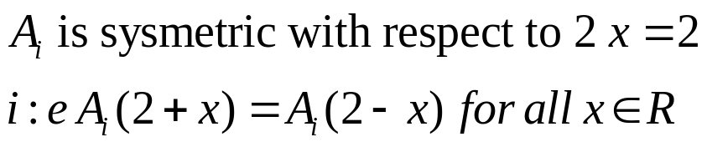

Let us consider four fuzzy sets whose membership function are shown in fig.
Each fuzzy set express in a particular form, the general conception of class of real nor that are close to 2.
The four fuzzy sets are similar in sense that following properties posses by each .
  .
  decreases monotonically from 1 to 0 with increasing
  difference |2-x|.

Slide 42
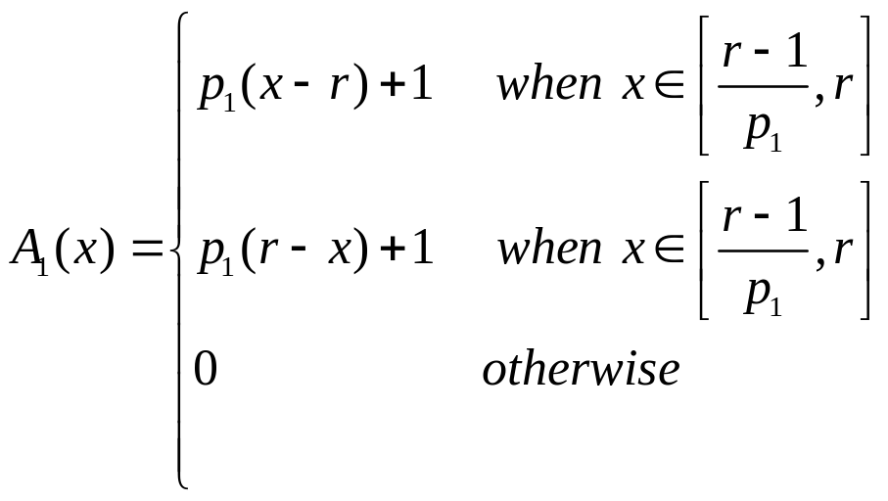
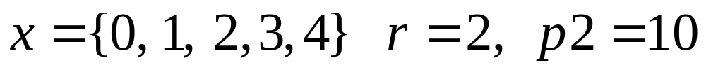
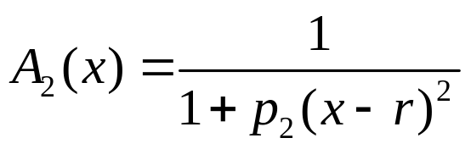
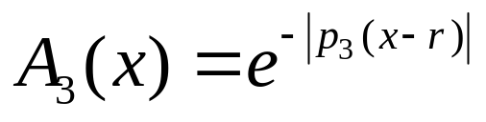
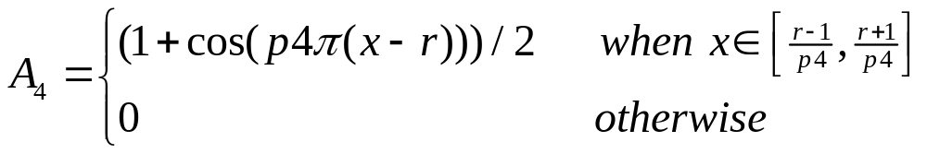

Slide 44
Consider a statement “ a comfortable house for a three persons” where the available houses have up to eight rooms.
The above statement can be described in fuzzy set A

Slide 45
Application Fuzzy systems
Fuzzy Control Systems
Fuzzy

Slide 46
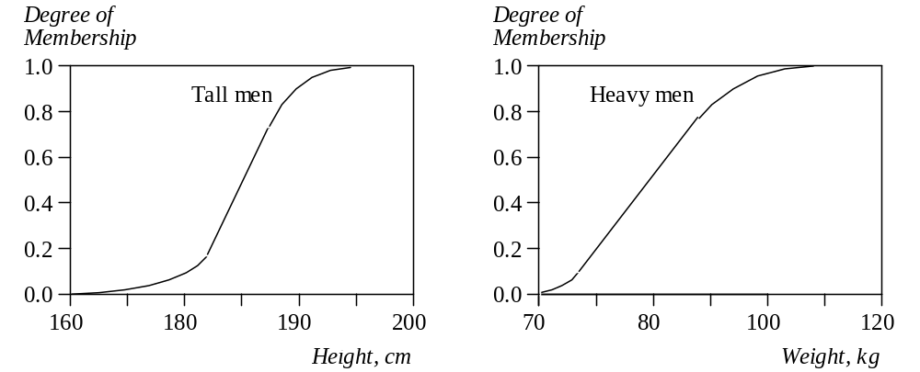
Firing Fuzzy Rules
These fuzzy sets provide the basis for a weight estimation model. The model is based on a relationship between a man’s height and his weight:
IF height is tall
THEN weight is heavy
Bogdan L. Vrusias © 2006

Slide 47
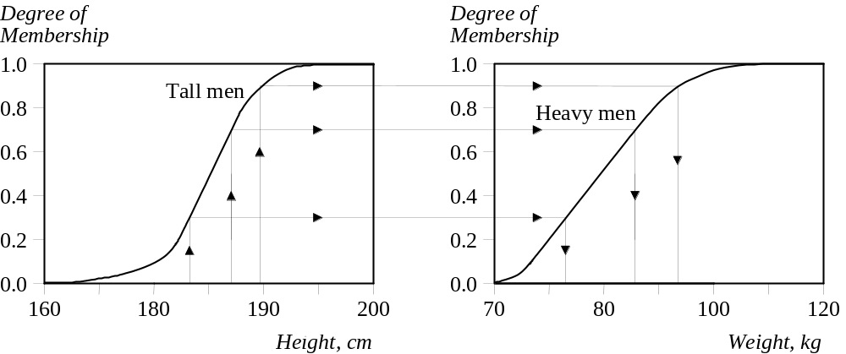
Firing Fuzzy Rules
The value of the output or a truth membership grade of the rule consequent can be estimated directly from a corresponding truth membership grade in the antecedent. This form of fuzzy inference uses a method called monotonic selection.
09th October 2006
Bogdan L. Vrusias © 2006

Slide 48
Firing Fuzzy Rules
A fuzzy rule can have multiple antecedents, for example:
IF project_duration is long
AND project_staffing is large
AND project_funding is inadequate
THEN risk is high
IF service is excellent
OR food is delicious
THEN tip is generous
The consequent of a fuzzy rule can also include multiple parts, for instance:
IF temperature is hot
THEN hot_water is reduced;
cold_water is increased

Slide 49
Fuzzy Sets Example (Air-conditioning)
Air-conditioning involves the delivery of air which can be warmed or cooled and have its humidity raised or lowered.
An air-conditioner is an apparatus for controlling, especially lowering, the temperature and humidity of an enclosed space. An air-conditioner typically has a fan which blows/cools/circulates fresh air and has cooler and the cooler is under thermostatic control. Generally, the amount of air being compressed is proportional to the ambient temperature.
Consider Johnny’s air-conditioner which has five control switches: COLD, COOL, PLEASANT, WARM and HOT. The corresponding speeds of the motor controlling the fan on the air-conditioner has the graduations: MINIMAL, SLOW, MEDIUM, FAST and BLAST.
09th October 2006
Bogdan L. Vrusias © 2006

Slide 50
Fuzzy Sets Example
The rules governing the air-conditioner are as follows:
RULE 1:
  IF TEMP is COLD THEN SPEED is MINIMAL
RULE 2:
  IF TEMP is COOL THEN SPEED is SLOW
RULE 3:
  IF TEMP is PLEASANT THEN SPEED is MEDIUM
RULE 4:
  IF TEMP is WARM THEN SPEED is FAST
RULE 5:
  IF TEMP is HOT THEN SPEED is BLAST
09th October 2006
Bogdan L. Vrusias © 2006

Slide 51
Fuzzy Sets Example
The temperature graduations are related to Johnny’s perception of ambient temperatures.
where:
Y : temp value belongs to the set (0<μ_{A}(x)<1)
Y* : temp value is the ideal member to the set (μ_{A}(x)=1)
N : temp value is not a member of the set (μ_{A}(x)=0)
Temp (⁰C). | COLD | COOL | PLEASANT | WARM | HOT
0 | Y* | N | N | N | N
5 | Y | Y | N | N | N
10 | N | Y | N | N | N
12.5 | N | Y* | N | N | N
15 | N | Y | N | N | N
17.5 | N | N | Y* | N | N
20 | N | N | N | Y | N
22.5 | N | N | N | Y* | N
25 | N | N | N | Y | N
27.5 | N | N | N | N | Y
30 | N | N | N | N | Y*
09th October 2006
Bogdan L. Vrusias © 2006

Slide 52
Fuzzy Sets Example
Johnny’s perception of the speed of the motor is as follows:
where:
Y : temp value belongs to the set (0<μ_{A}(x)<1)
Y* : temp value is the ideal member to the set (μ_{A}(x)=1)
N : temp value is not a member of the set (μ_{A}(x)=0)
Rev/sec (RPM) | MINIMAL | SLOW | MEDIUM | FAST | BLAST
0 | Y* | N | N | N | N
10 | Y | N | N | N | N
20 | Y | Y | N | N | N
30 | N | Y* | N | N | N
40 | N | Y | N | N | N
50 | N | N | Y* | N | N
60 | N | N | N | Y | N
70 | N | N | N | Y* | N
80 | N | N | N | Y | Y
90 | N | N | N | N | Y
100 | N | N | N | N | Y*
09th October 2006
Bogdan L. Vrusias © 2006

Slide 53
Fuzzy Sets Example
The analytically expressed membership for the reference fuzzy subsets for the temperature are:
COLD:
  for 0 ≤ t ≤ 10 μ_{COLD}(t) = – t / 10 + 1
SLOW:
  for 0 ≤ t ≤ 12.5 μ_{SLOW}(t) = t / 12.5
  for 12.5 ≤ t ≤ 17.5 μ_{SLOW}(t) = – t / 5 + 3.5
etc… all based on the linear equation:
  y = ax + b
09th October 2006
Bogdan L. Vrusias © 2006

Slide 54
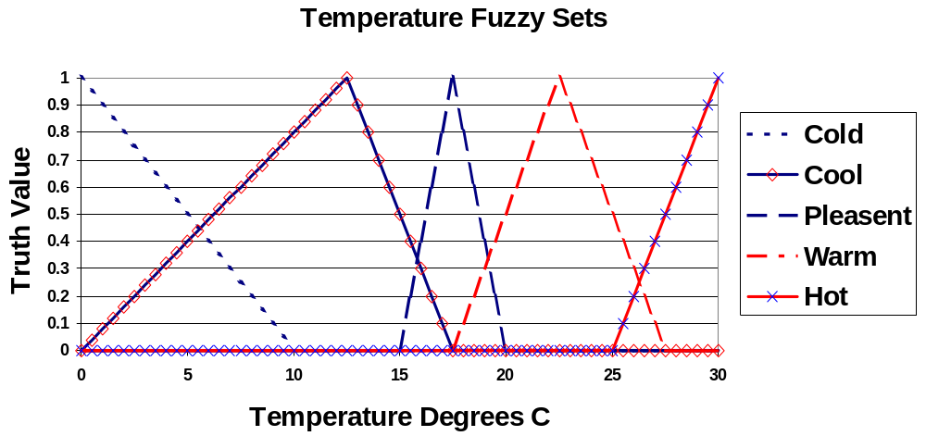
Fuzzy Sets Example
09th October 2006
Bogdan L. Vrusias © 2006

Slide 55
Fuzzy Sets Example
The analytically expressed membership for the reference fuzzy subsets for the temperature are:
MINIMAL:
  for 0 ≤ v ≤ 30 μ_{COLD}(t) = – v / 30 + 1
SLOW:
  for 10 ≤ v ≤ 30 μ_{SLOW}(t) = v / 20 – 0.5
  for 30 ≤ v ≤ 50 μ_{SLOW}(t) = – v / 20 + 2.5
etc… all based on the linear equation:
  y = ax + b
09th October 2006
Bogdan L. Vrusias © 2006

Slide 56
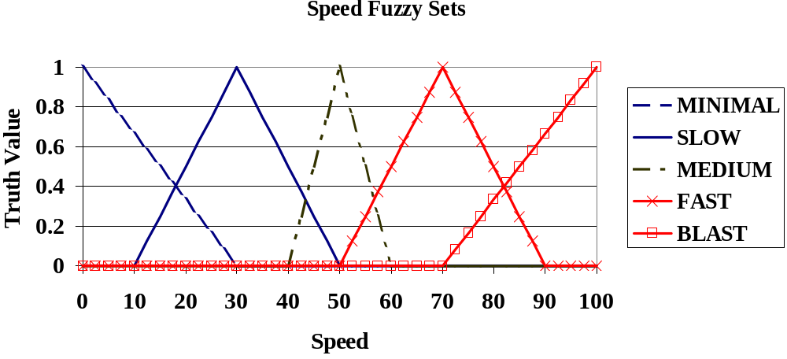
Fuzzy Sets Example
09th October 2006
Bogdan L. Vrusias © 2006

Slide 57
Examples on Industrial Applications
Cement Klin: It is rotatory chamber in which ground limestone and clay react with each other at temperatures of 1000-1400c fuzzy logic controler has been used by Holmbald and Ostergraard.
Heat exchange Process: The core of heat exchanger is two hydraulic systems: hot and cold water circuits.
Boiler and Steam Engine: The steam engine speed was controlled by adjusting the input cylinder, while the boiler pressure was controlled by heat.

Slide 58
Water Purification Plant: raw water is purified by injecting chemicals related to water quality.
Aluminum sulfate (polymerized aluminum chloride)
Example:
if TUUP =MM then DDOS=PS
if TUUP=ML then DDOS=PM
Fuzzy variables
Where TUUP =grade of water,
DDOS=amount of compensate dose,
MM=Medium,
PS=Positive small
PM=Positive Medium

Slide 59
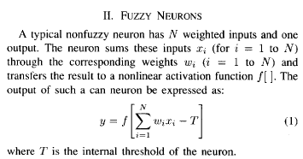
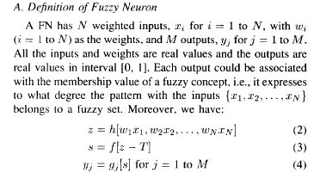

Slide 60
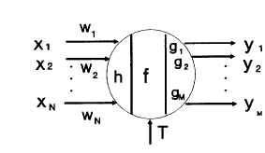
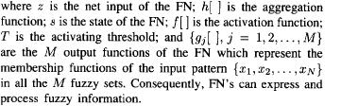
Fuzzy neuron

Slide 61
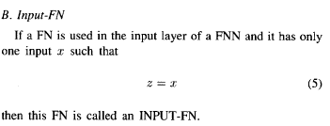



Slide 62



Slide 63


